Slide 1
Human Resource Analytics
Using Machine Learning Algorithms
INFO 8000
Oje Adurangba Victor

Slide 2
Background & Significance
Employee attrition can be a challenging exercise for the human resource team
Delay in project completion
Stressful exercise
Additional cost
Reduced effectiveness of team dynamics- project management
Loss of customer relationships
“You take away our top 20 employees and we become a mediocre company” – Bill Gates

Slide 3
Problem Statement
Identifies factors that leads to employee attrition
Modelling using different machine learning algorithms that can be used to predict employee attrition
Best predictive analytics(accuracy) of employee attrition
Identify most important features that are responsible for employee attrition

Slide 4
Layout
Data summary
Exploratory data analysis
Feature engineering
Data preprocessing
Binary classification
Feature selection
Modelling with different algorithms
Predictive analysis
Variable importance

Slide 5
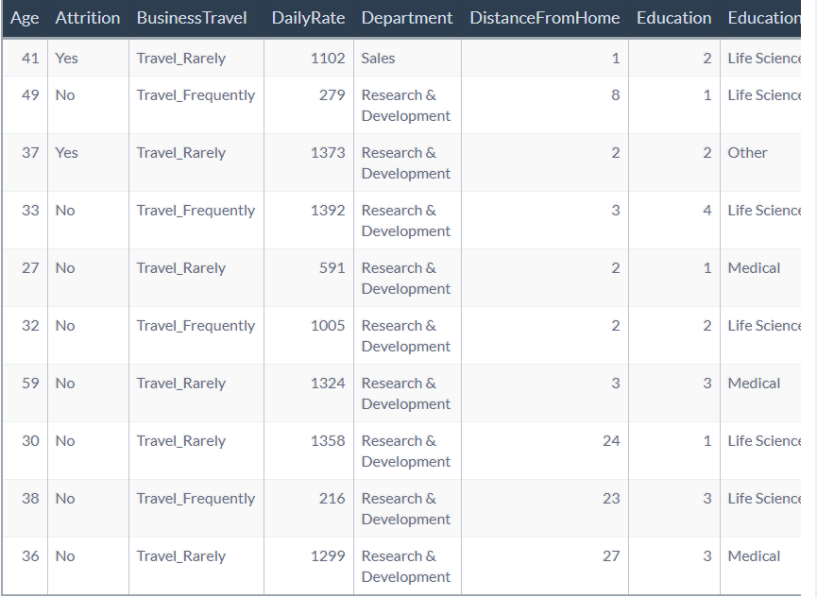
Data summary
HR Dataset by IBM
Simulated HR Database
Representative of real-world data
35 Features
1470 employees
Source: https://www.ibm.com/communities/analytics/watson-analytics-blog/hremployee-attrition

Slide 6
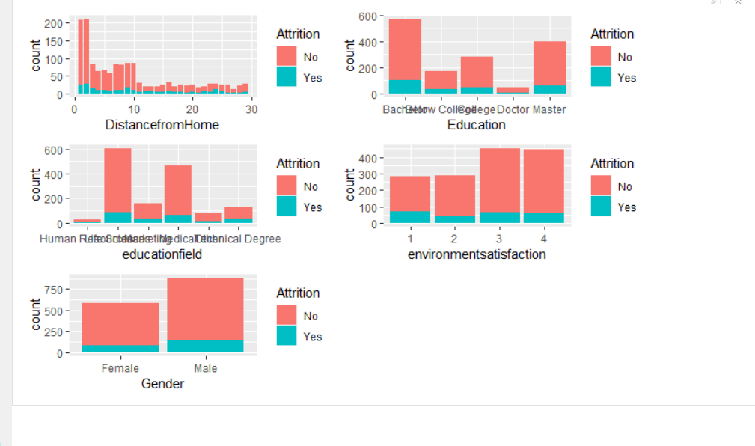
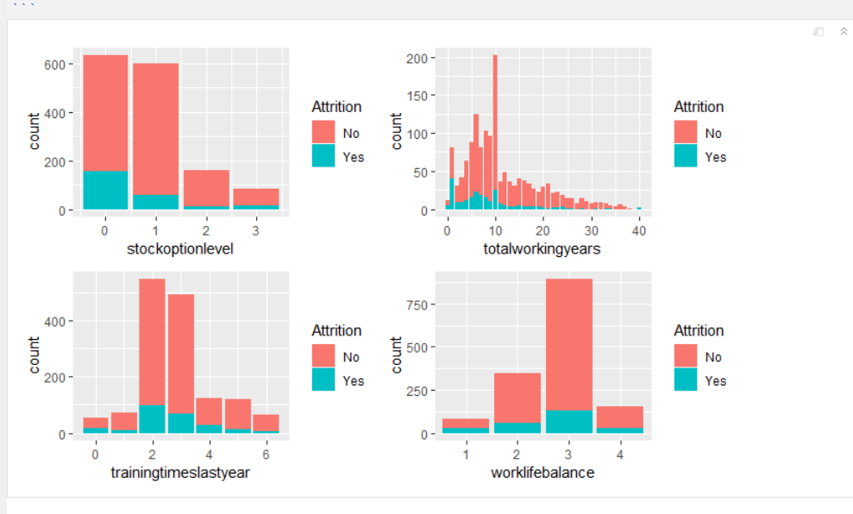
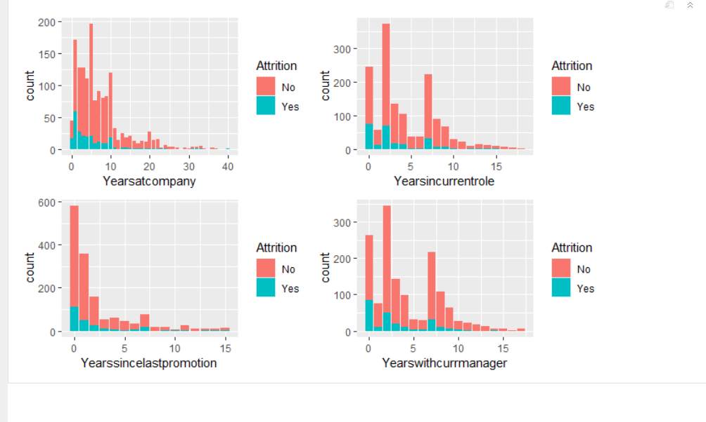
Exploratory data analysis

Slide 7
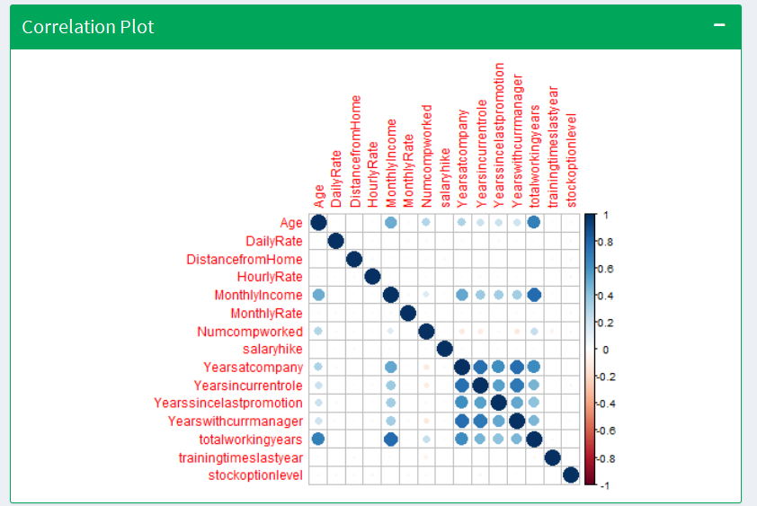
Exploratory data analysis

Slide 8
Feature engineering
Age group
Total Satisfaction
Job Class(Directors/Staff)
Income level(Low, High)
Years without change(Total working years without change in promotion)

Slide 9
Binary Classification
Before Balancing data
No Attrition | Attrition
83.87 % | 16.12 %
Using Smote to balance data
No Attrition | Attrition
57.14% | 42.85%

Slide 10
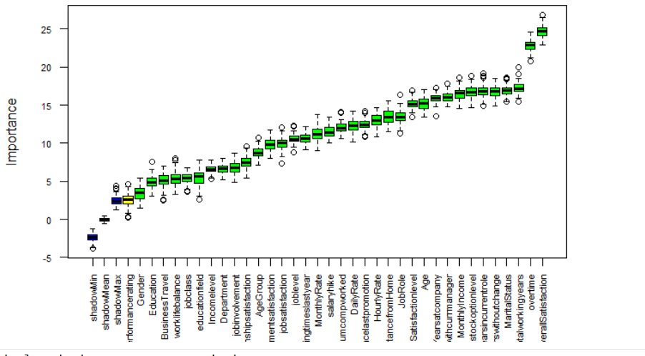
Feature selection
Using Boruta
Performance rating is found to be not important

Slide 11
Modelling
Methods used
Logistic regression
Random forest
Support vector machine
Extreme gradient boosting

Slide 12
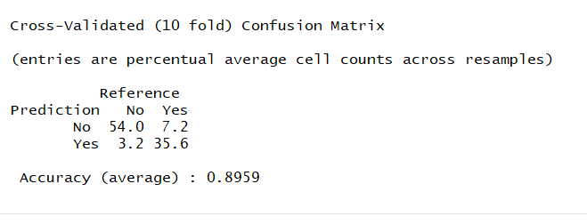
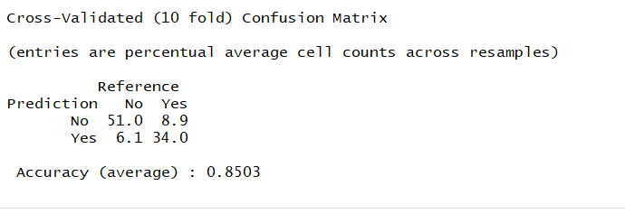
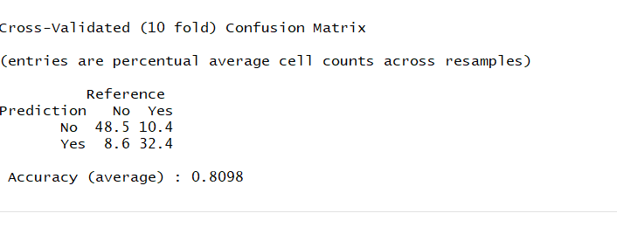
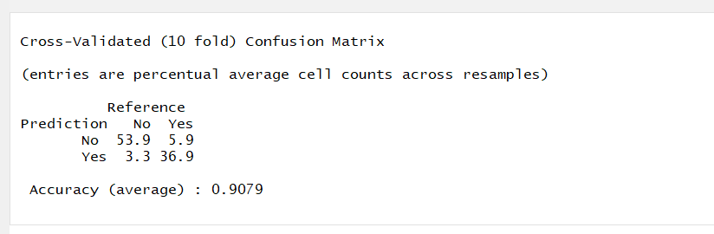
Modelling
Random forest
Support vector machine
Logistic regression
Extreme gradient boost

Slide 13
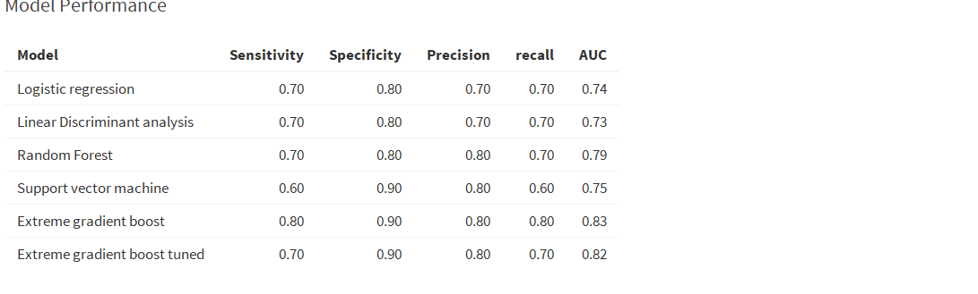
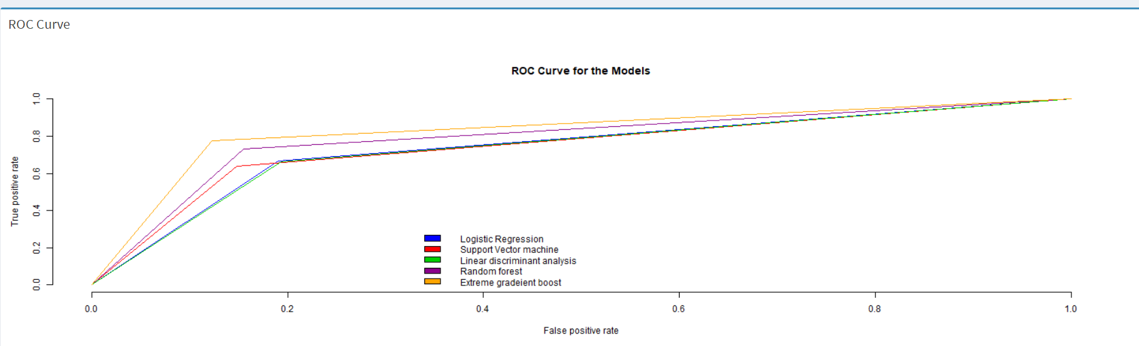
Prediction

Slide 14
Variable importance and implications
Extreme gradient boost provided the most important accurate prediction- ROC Curve
The five most important factors affecting employee attrition are
Overtime
Overall satisfaction
Job role
Years without change
Monthly income
Recall/Sensitivity(True positive rate): Critical to the business
Will correctly classify employees who will leave 80 times out of 100
When it is actually yes, how often does it predict yes?
Specificity(True negative rate)
When it is actually no, how often does it predict no?
Will correctly classify employees who will stay 90 times out of 100
Precision:
When it predicts yes for employee attrition, how often is it correct?
Will avoid incorrectly assigning Yes 80% of the time.

Slide 15
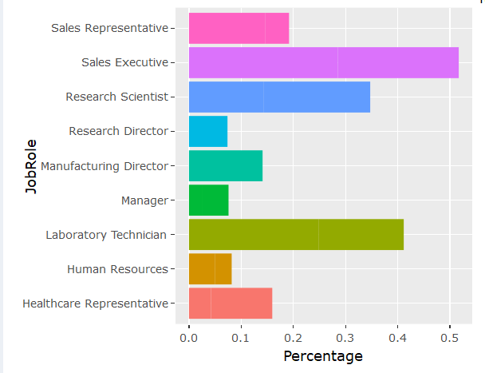
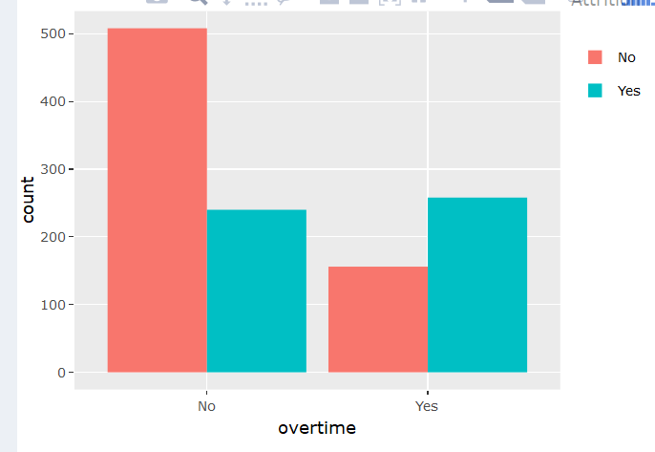
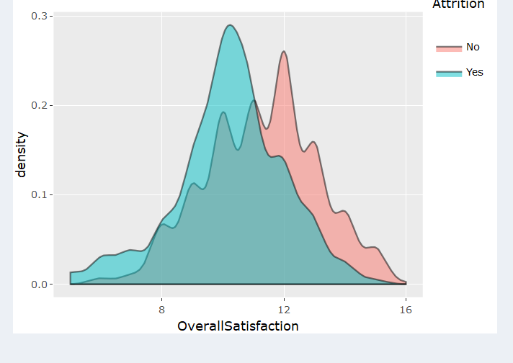
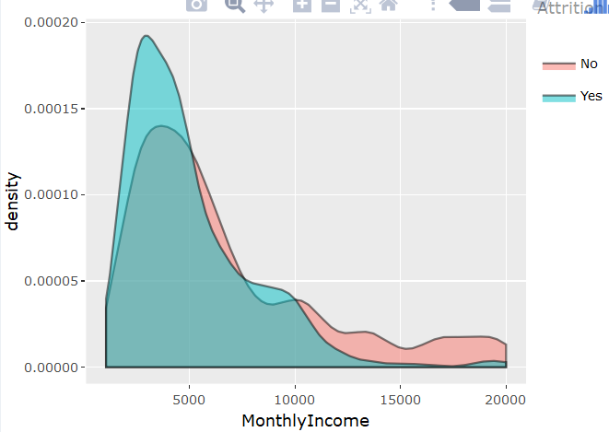
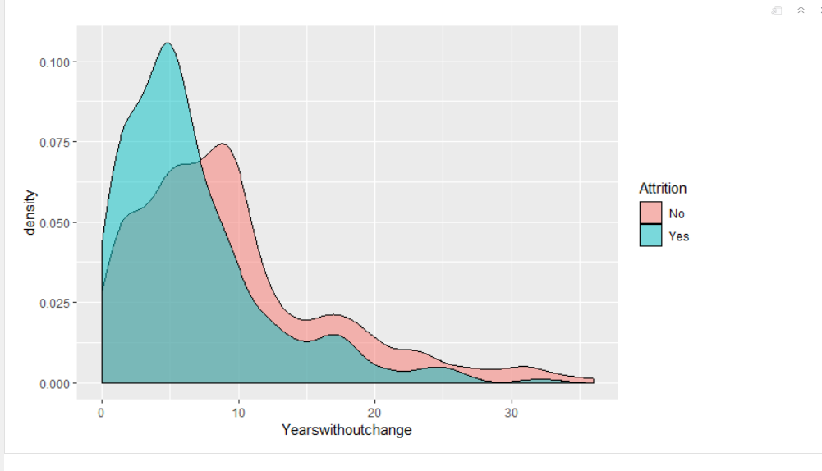

Slide 16
THANK YOU!!!

